Slide 1
Theory of Automata Introduction to Turing Machine
Dr. Sabina Akhtar

Slide 2
Revision

Slide 3
Turing machine
First proposed by Alan Turing in 1936
Similar to finite automaton but with an unlimited and unrestricted memory
A Turing machine can do everything that a real computer can do. Except certain problems that are beyond the theoretical limits of computation.

Slide 4
Turing Machines
The purpose of the theory of Turing machines is to prove that certain specific languages have no algorithm.
If a problem cannot be “solved” even using a TM, then it implies that the problem is undecidable
What does this mean?
They are used to prove a given system.

Slide 5
Picture of a Turing Machine
Action: based on
the state and the
tape symbol under
the head: change
state, rewrite the
symbol and move the
head one square.
State
. . .
A
B
C
A
D
. . .
Infinite tape with
squares containing
tape symbols chosen
from a finite alphabet

Slide 6
Why Turing Machines?
Why not deal with C programs or something like that?
Answer: You can, but it is easier to prove things about TM’s, because they are so simple.
And yet they are as powerful as any computer.
More so, in fact, since they have infinite memory.

Slide 7
Turing-Machine Formalism
A TM is described by:
A finite set of states (Q, typically).
An input alphabet (Σ, typically).
A tape alphabet (Γ, typically; contains Σ).
A transition function (δ, typically).
A start state (q₀, in Q, typically).
A blank symbol (B, in Γ- Σ, typically).
All tape except for the input is blank initially.
A set of final states (F ⊆ Q, typically).

Slide 8
Conventions
a, b, … are input symbols.
…, X, Y, Z are tape symbols.
…, w, x, y, z are strings of input symbols.
α, β,… are strings of tape symbols.

Slide 9
The Transition Function
Takes two arguments:
A state, in Q.
A tape symbol in Γ.
δ(q, Z) is either undefined or a triple of the form (p, Y, D).
p is a state.
Y is the new tape symbol.
D is a direction, L or R.

Slide 10
Actions of the TM
If δ(q, Z) = (p, Y, D) then, in state q, scanning Z under its tape head, the TM:
Changes the state to p.
Replaces Z by Y on the tape.
Moves the head one square in direction D.
D = L: move left; D = R; move right.

Slide 11
Example: Turing Machine
This TM scans its input right, looking for a 1.
If it finds one, it changes it to a 0, goes to final state f, and halts.
If it reaches a blank, it changes it to a 1 and moves left.

Slide 12
Example: Turing Machine – (2)
States = {q (start), f (final)}.
Input symbols = {0, 1}.
Tape symbols = {0, 1, B}.
δ(q, 0) = (q, 0, R).
δ(q, 1) = (f, 0, R).
δ(q, B) = (q, 1, L).

Slide 13
Simulation of TM
δ(q, 0) = (q, 0, R)
δ(q, 1) = (f, 0, R)
δ(q, B) = (q, 1, L)
q
. . . B B 0 0 B B . . .

Slide 14
Simulation of TM
δ(q, 0) = (q, 0, R)
δ(q, 1) = (f, 0, R)
δ(q, B) = (q, 1, L)
q
. . . B B 0 0 B B . . .

Slide 15
Simulation of TM
δ(q, 0) = (q, 0, R)
δ(q, 1) = (f, 0, R)
δ(q, B) = (q, 1, L)
q
. . . B B 0 0 B B . . .

Slide 16
Simulation of TM
δ(q, 0) = (q, 0, R)
δ(q, 1) = (f, 0, R)
δ(q, B) = (q, 1, L)
q
. . . B B 0 0 1 B . . .

Slide 17
Simulation of TM
δ(q, 0) = (q, 0, R)
δ(q, 1) = (f, 0, R)
δ(q, B) = (q, 1, L)
q
. . . B B 0 0 1 B . . .

Slide 18
Simulation of TM
δ(q, 0) = (q, 0, R)
δ(q, 1) = (f, 0, R)
δ(q, B) = (q, 1, L)
f
No move is possible.
The TM halts and
accepts.
. . . B B 0 0 0 B . . .

Slide 19
Class Activity
Example: L = {0^{n}1^{n} | n≥1}
Strategy: w = 000111
…
B
B
0
0
0
1
1
1
B
B
…
…
B
B
X
X
0
Y
Y
1
B
B
…
…
…
…
B
B
X
0
0
1
1
1
B
B
…
B
B
X
X
X
Y
Y
1
B
B
…
…
…
…
B
B
X
0
0
Y
1
1
B
B
…
B
B
X
X
X
Y
Y
Y
B
B
…
…
…
B
B
X
X
0
Y
1
1
B
B
…
B
B
X
X
X
Y
Y
Y
B
B
…
Accept

Slide 21
Class Activity
Provide the formal definition of the turing machine for the example.
Draw the transition diagram.

Slide 22
TM for {0^{n}1^{n} | n≥1}
Y / Y,R
Mark next unread 0 with X and move right
Move to the right all the way to the first unread 1, and mark it with Y
Move back (to the left) all the way to the last marked X, and then move one position to the right
If the next position is 0, then goto step 1. Else move all the way to the right to ensure there are no excess 1s. If not move right to the next blank symbol and stop & accept.
0 / 0,R
0 / X,R
q₀
q₁
Y / Y,R
1 / Y,L
X / X,R
q₂
Y / Y,R
q₃
B / B,R
Y / Y,L
0 / 0,L
q₄

Slide 23
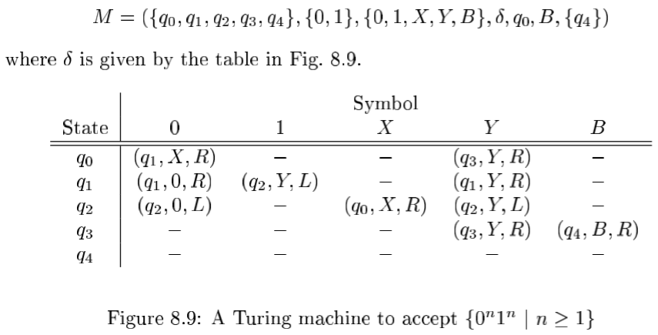
Solution
Formal definition:

Slide 24
Instantaneous Descriptions of a Turing Machine
Initially, a TM has a tape consisting of a string of input symbols surrounded by an infinity of blanks in both directions.
The TM is in the start state, and the head is at the leftmost input symbol.

Slide 25
TM ID’s – (2)
An ID is a string αqβ, where αβ is the tape between the leftmost and rightmost nonblanks (inclusive).
The state q is immediately to the left of the tape symbol scanned.
If q is at the right end, it is scanning B.
If q is scanning a B at the left end, then consecutive B’s at and to the right of q are part of α.

Slide 26
TM ID’s – (3)
As for PDA’s we may use symbols ⊦ and ⊦* to represent “becomes in one move” and “becomes in zero or more moves,” respectively, on ID’s.
Example: The moves of the previous TM are q00⊦0q0⊦00q⊦0q01⊦00q1⊦000f

Slide 27
Formal Definition of Moves
If δ(q, Z) = (p, Y, R), then
αqZβ⊦αYpβ
If Z is the blank B, then also αq⊦αYp
If δ(q, Z) = (p, Y, L), then
For any X, αXqZβ⊦αpXYβ
In addition, qZβ⊦pBYβ

Slide 28
Languages of a TM
A TM defines a language by final state, as usual.
L(M) = {w | q₀w⊦*I, where I is an ID with a final state}.
Or, a TM can accept a language by halting.
H(M) = {w | q₀w⊦*I, and there is no move possible from ID I}.

Slide 29
Way to check for Membership
Is a string w accepted by a TM?
Initial condition:
The (whole) input string w is present in TM, preceded and followed by infinite blank symbols
Final acceptance:
Accept w if TM enters final state and halts
If TM halts and not final state, then reject

Slide 30
Solution
Formal definition:

Slide 31
Example
Provide the entire sequence of moves of M when M’s intial ID is
q₀0011
q₀0010

Slide 32
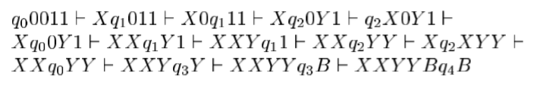
Example
Provide the entire sequence of moves of M when M’s intial ID is
q₀0011
q₀0010

Slide 33
Class Activity
Provide the entire sequence of moves of M when M’s intial ID is
q₀0011
q₀0010

Slide 34

Solution

Slide 35
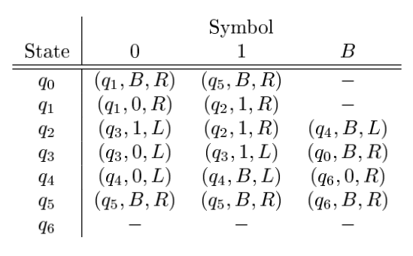
Class Activity
Simulate the w = 0001000 & w= 0010 using the following Turing Machine.

Slide 36
Design TM for {0^{n}1^{n}2^{n}| n≥1}
Y / Y,R
Mark next unread 0 with X and move right
Move to the right all the way to the first unread 1, and mark it with Y
Move back (to the left) all the way to the last marked X, and then move one position to the right
If the next position is 0, then goto step 1. Else move all the way to the right to ensure there are no excess 1s. If not move right to the next blank symbol and stop & accept.
0 / 0,R
0 / X,R
q₀
q₁
Y / Y,R
1 / Y,L
X / X,R
q₂
Y / Y,R
q₃
B / B,R
Y / Y,L
0 / 0,L
q₄

Slide 37
References
Book Chapter
Lectures from Stanford University
http://infolab.stanford.edu/~ullman/ialc/spr10/spr10.html#LECTURE%20NOTES
Lectures from Washington State University
http://www.eecs.wsu.edu/~ananth/CptS317/Lectures/

